Slide 1
CS112 : Introduction to Python Programming
Week 8: lab practice

Slide 2
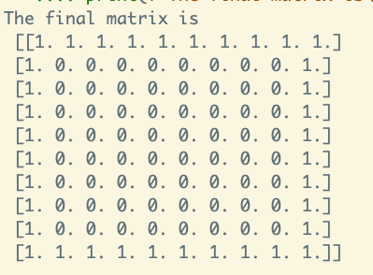
Practice 1
Create a 10 x 10 arrays of zeros and then "frame" it with a border of ones:

Slide 3
Practice 2
The following two arrays y, and t are respectively the position vs. time of a falling object, say a ball. Please calculate the average velocity as a function of time:
y = np.array([0., 1.3, 5. , 10.9, 18.9, 28.7, 40.])
t = np.array([0., 0.49, 1. , 1.5 , 2.08, 2.55, 3.2])

Slide 4
Practice 3
Create an 8x8 matrix and fill it with a checkerboard pattern.
Expected output:
[[0 1 0 1 0 1 0 1]
[1 0 1 0 1 0 1 0]
[0 1 0 1 0 1 0 1]
[1 0 1 0 1 0 1 0]
[0 1 0 1 0 1 0 1]
[1 0 1 0 1 0 1 0]
[0 1 0 1 0 1 0 1]
[1 0 1 0 1 0 1 0]]

Slide 5
Practice 4
Create a 5 × 5 array with its (i,j)-entry equal to i+j :

